Slide 1
Internship Final Presentation
Ta Quang Tung - 104222196
Summer 2025 - ICT20016 - Work Integrated Learning Placement

Slide 2
Table of contents
01
02
03
04
Executive Summary
Timeline & Scope
A brief overview of NashTech Vietnam.
What I did in my 12 weeks of internship.
Deliverables & Lessons
Development Plan
What I have learned and achieved.
My next steps after NashTech.

Slide 3

01
Executive Summary

Slide 4
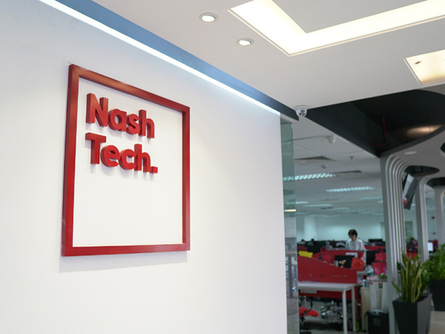
An overview of NashTech
Global outsourcing company that provides custom software development and digital solutions.
25 years of experience. 11 offices across 9 countries with 2000+ engineers.
NashTech has a Hanoi office in Xuan Thuy St.

Slide 5


Technology and methodology
Microsoft .NET
Agile
Predominant backend tech.
Has 3 Microsoft MVPs.
Nearly all projects follow Agile.
Engagement 83% more successful than industry standards.
…plus more depending on the project.

Slide 6
02
Timeline & Scope

Slide 7
Internship timeline
Training
C#, ASP.NET, EF Core, ReactJS
Phase 1
(6 weeks)
Mid assignment
Individual assignment
Internship
(12 weeks)
Work in groups to complete a mock project for a Mentoring Platform
Phase 2
(6 weeks)
Mock project
English and soft skills training throughout.
Notes:
Describe mid-assignment and mock project: full-stack web app, backend ASP.NET, frontend Reactjs. In mock project we also worked with a testing team.

Slide 8
Work scope
Attend
Do assignments
Mock project
Training sessions and work hours. Our attendance was tracked.
Complete training and mid-assignment in phase 1.
No real project, just a mock project to test us on Phase 2.
Lives up to its name: Work-Integrated Learning.

Slide 9
03
Deliverables & Lessons

Slide 10
Key deliverables
Product: Mentor Platform mock project
Frontend developer (mainly) + some backend.
Source code and final presentation.
Process: Scrum
We were required to use Scrum framework.
I was the tech lead.
We were assessed in terms of how well we understood and followed the process.

Slide 11
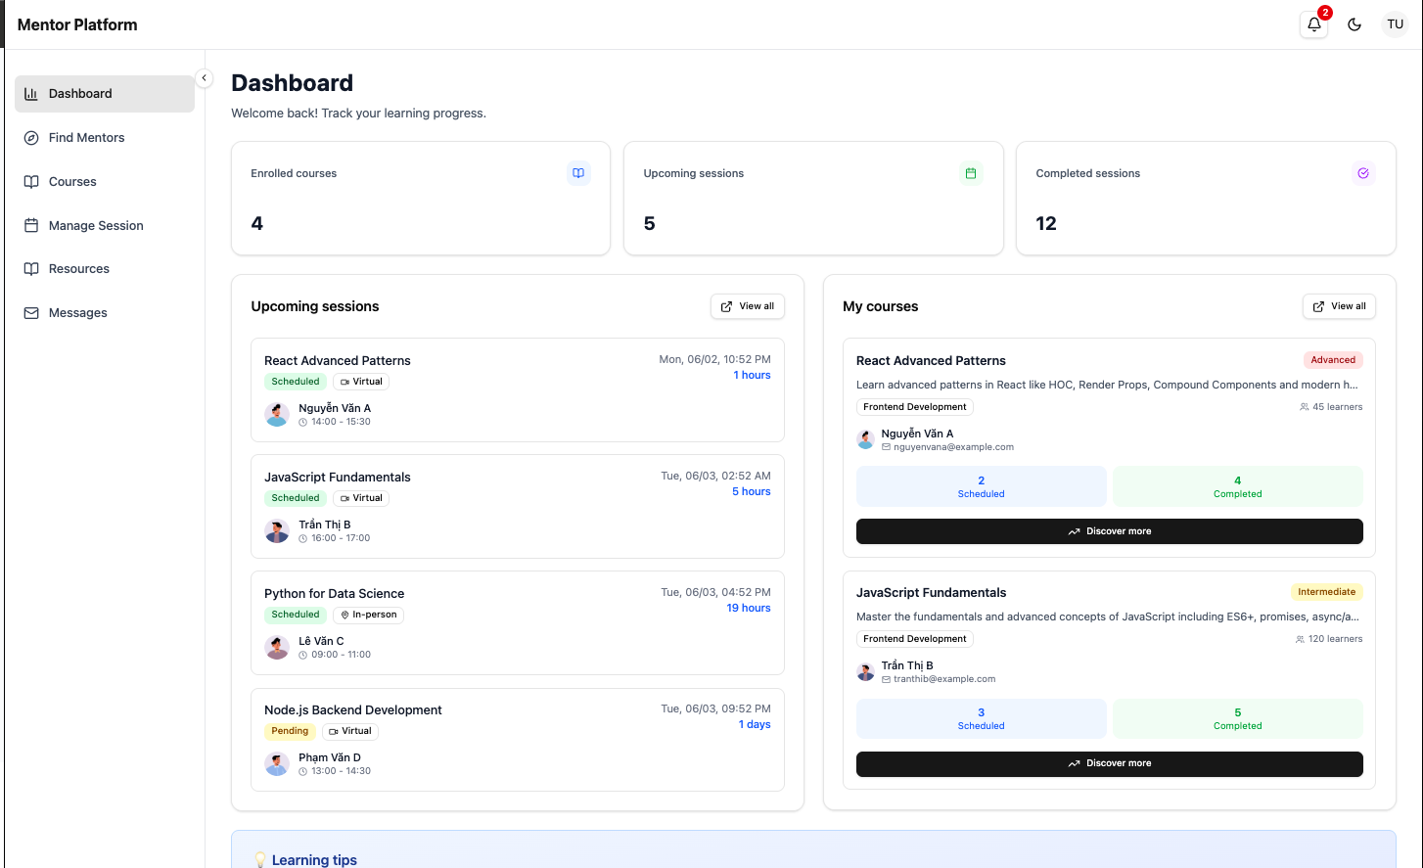
Sample UI

Slide 12
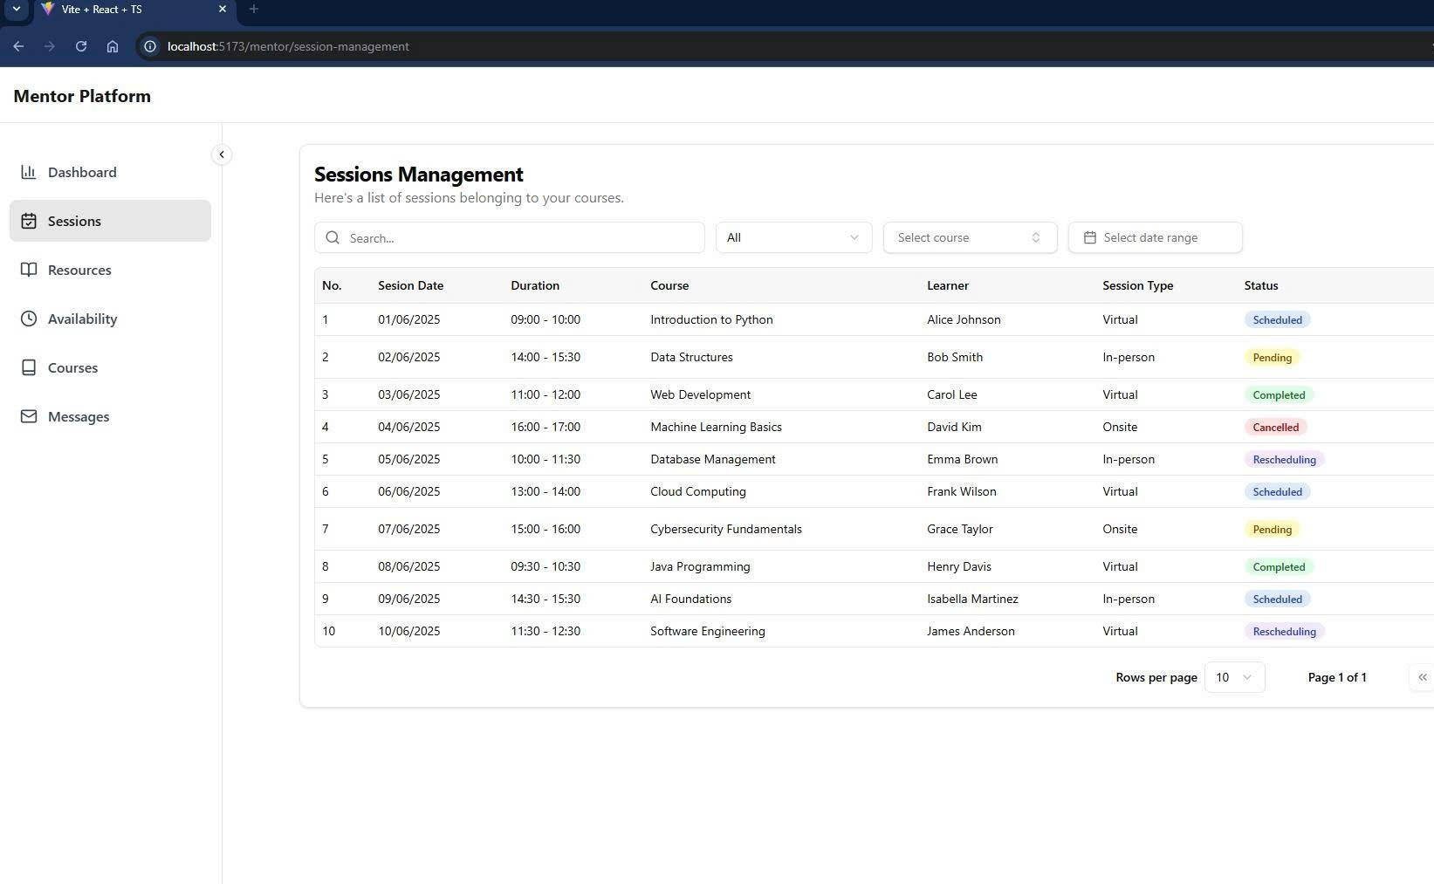
Sample UI

Slide 13
Lessons learned
Frameworks
ASP.NET, ReactJS
Hard
Collaborative GitHub, deployment pipelines, database management, cloud
DevOps
Lessons
Agile
Scrum framework, Agile mindset
Soft
Leadership
Tech lead, leadership styles, teamwork issues
Notes:
Git-Flow

Slide 14
04
Development Plan

Slide 15



Next steps
Learn
AWS Cert
NAB Vietnam
Backend technologies like Spring. Also build strong frontend skills.
I want to be familiar with a cloud platform & AWS is the right choice for me.
After an enriching experience at an outsourcing company, I’d like to try out a product company.

Slide 16
Thanks!
Question time :)

